Slide 1

USNews Ratings of Large-Cap Growth Funds
COMPARING fund ratings and expense ratios

Slide 2



Why Large-Cap Growth Funds
Large-Cap has the largest participation.
Takes on a level of risk that Value Funds don’t.
More risk = more variability in performance.

Slide 3
Purpose
Is the premium you pay to invest in a certain mutual fund actually worth it?

Slide 4





Rankings Format
US News ranks mutual funds by averaging the rankings between the top investment research sites.
These include:
Morningstar
Lipper
CFRA
The Street
Zacks
***Long-Term Emphasis***

Slide 5
Expense Ratios Explained
Expense Ratios = Total Costs/Total Assets Under Management
Fees are not truly regulated, so they vary significantly when considered over time.
Expense fees usually breakdown into many different fees:
Sales Load
Purchase Fees/Redemption Fees/Exchange Fees
Management Fees
12b-1 Fees
A SMALL DIFFERENCE IN EXPENSE RATIOS CAN MAKE A LARGE IMPACT IN YOUR LONG-TERM PERFORMACE!

Slide 6
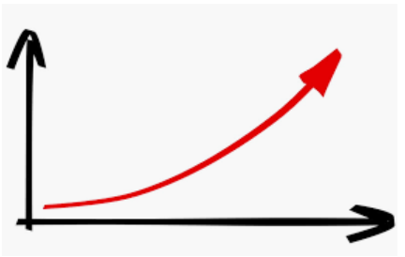
Logical Expectations
Higher rating = Better performance
Better performance = higher premium to pay/more expensive.
Higher rating = higher expense.

Slide 7
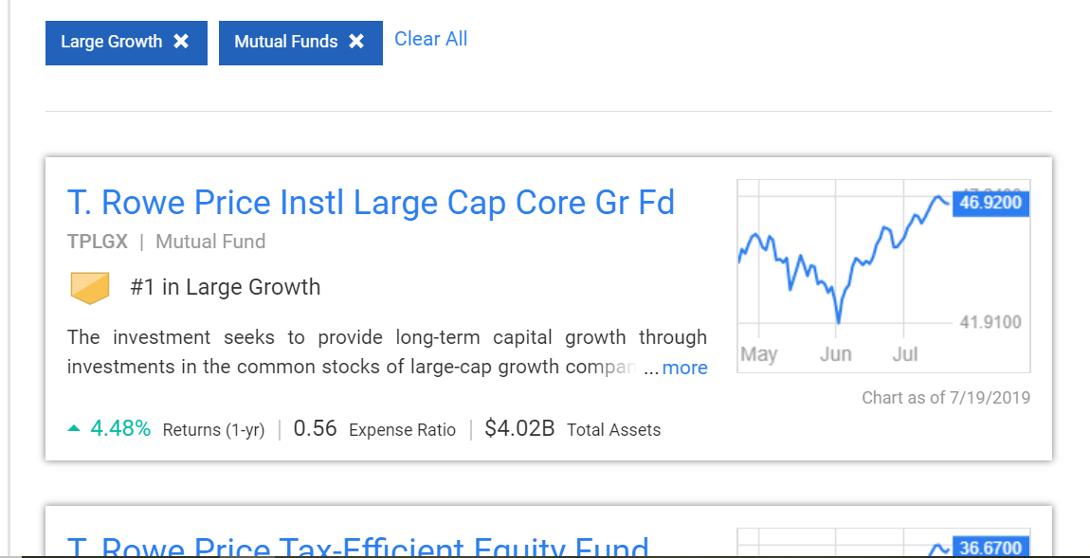
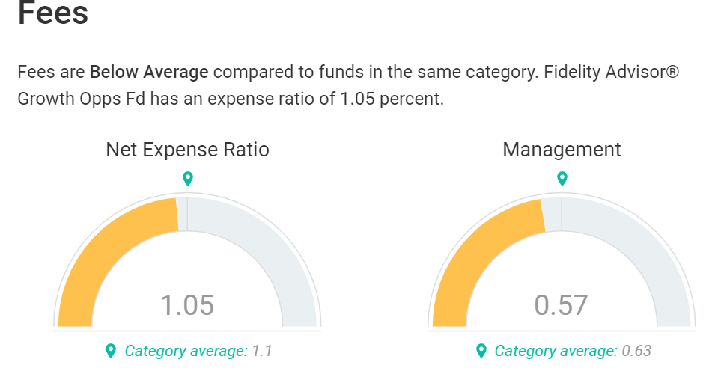
Scraping Process
Used Selenium to scroll through interactive page, close pop-ups, and load more content to gather fund ranks, names, Expense Ratio, and URL link. https://money.usnews.com/funds/mutual-funds/rankings/large-growth
Used URLs gathered to loop through individual fund pages to gather expense profile, risk profile, and tickers. Concatenated the two csv’s created and cleaned accordingly.

Slide 8
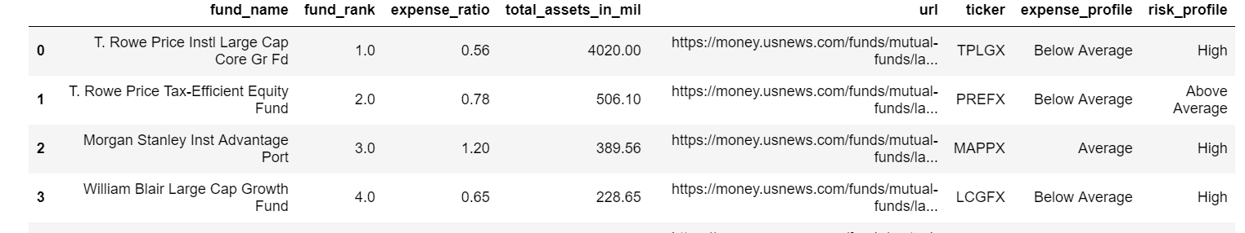
Data Gathered from USNews
After exploring the relationship between fund rank and expense ratio, we will explore the characteristics of those funds with lower expense ratios by way of their total assets under management and risk profile.

Slide 9
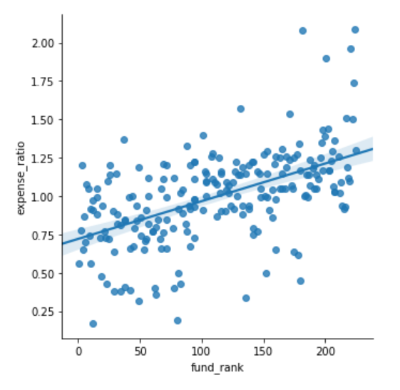
Rank & Expense Ratio
It turns out that the best-ranked mutual funds, on average, charge LESS than worse-ranked mutual funds.
Based on the rubric for ranking funds, the data suggests that top ranked stocks are not only better performers, but also the least expensive.

Slide 10
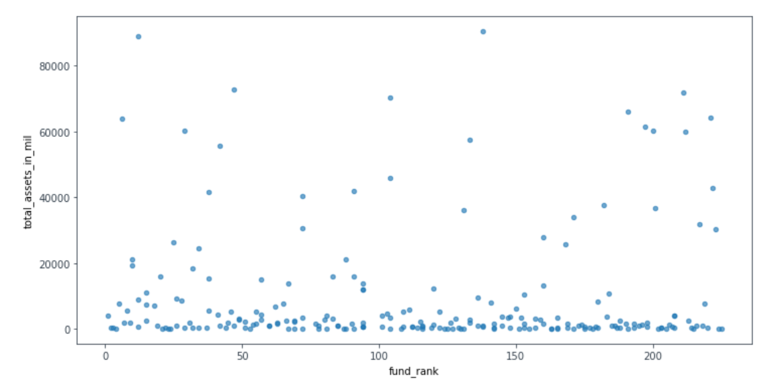
Do Assets Under Management explain Expense Ratio?
No relation between assets under management and expense ratio.

Slide 11
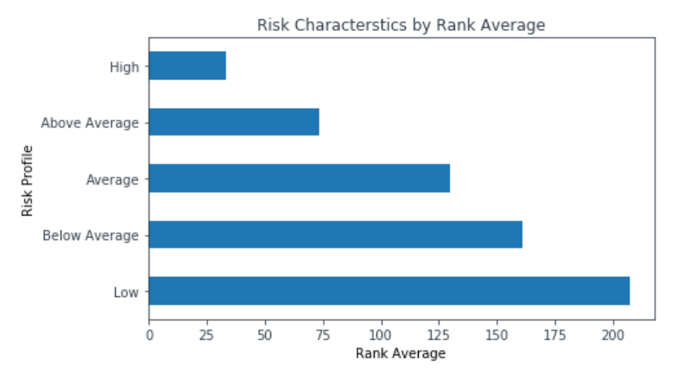
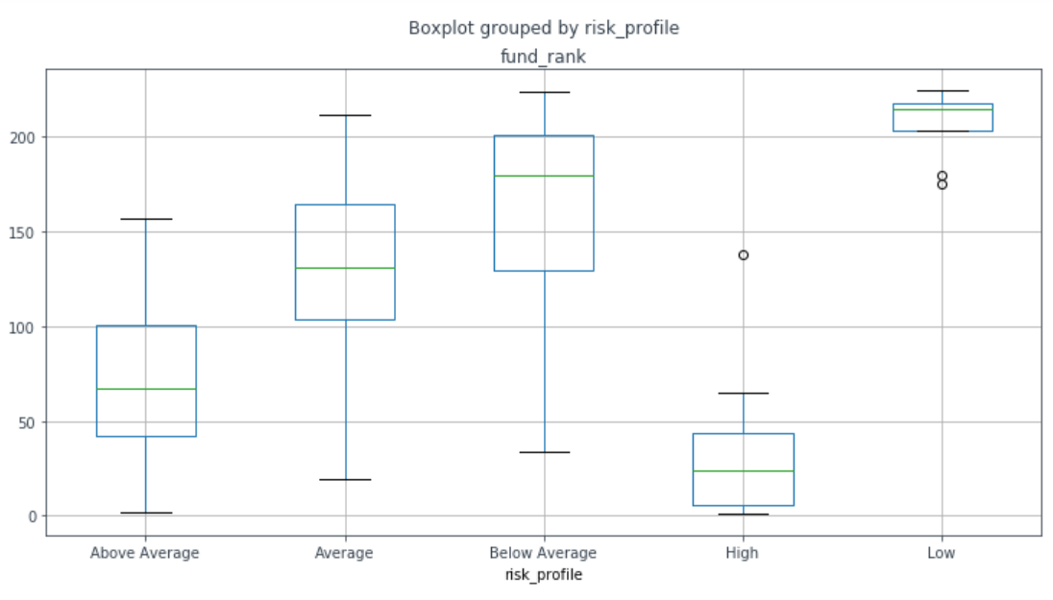
Risk Characteristics of the Top Ranked
The graph shows that higher-ranked funds are associated with more risk.
-Risk prospers in bull market, but what about performance in turbulent/bear market.
-Premium for safety?

Slide 12
Conclusions
According to the data gathered, the best-ranked funds have, on average, lower expense ratios than worst-ranked funds.
The best- ranked funds typically take on more risk than worse-ranked fund.
Assets under management don’t explain variance in expense ratios.
We need to assess these risk-taking funds to see how they perform in more turbulent and bearish markets.

Slide 13
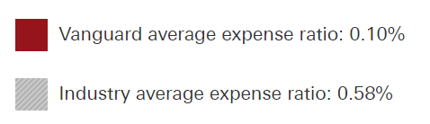
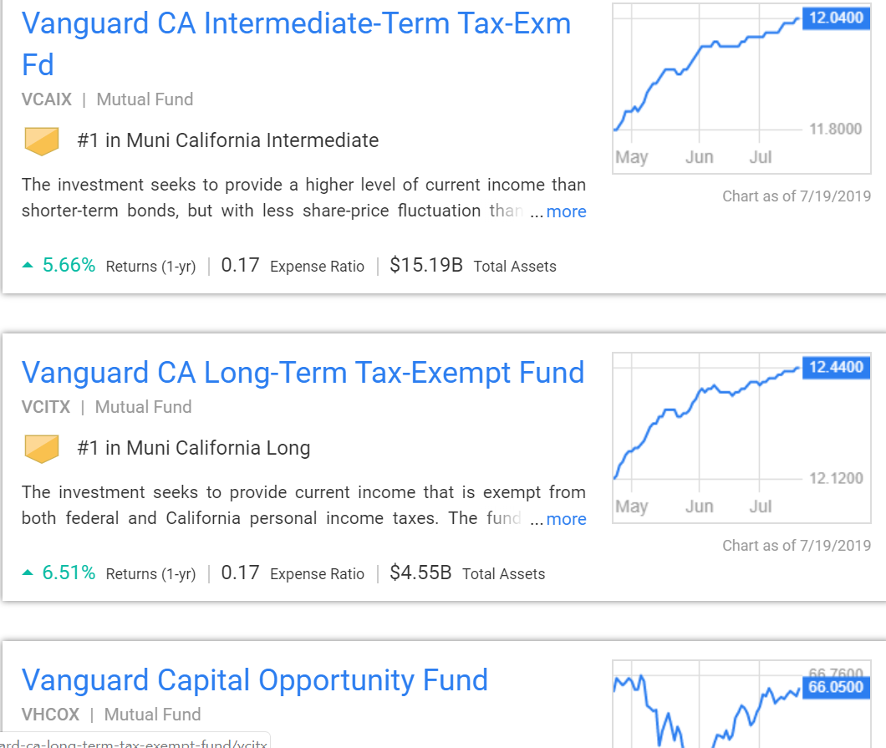
Further Considerations
Examine fund families, their expense fees relative to the aggregate, how they rank accordingly among other fund families.
Observe fund rankings over an entire economic cycle.
Consider fund turnover rates, and how that corresponds with their expenses and ranks.

Slide 14
QUESTIONS?

